Slide 1
“Tale of Wind and Water” (1997) Sakiyama Tami (1954-)
風水譚
崎山多美

Slide 2
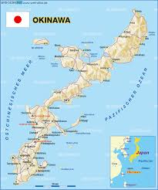
Map of Okinawa

Slide 3
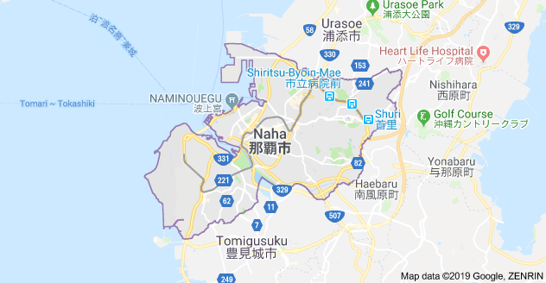
Map of Naha

Slide 4
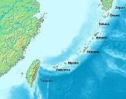
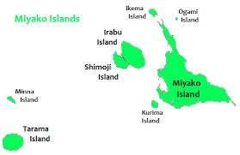
Map of Okinawa Islands & Miyako Islands

Slide 5
Keywords
Wind/Sea
Tale
Yamatu/Shimanchu
Naha, Tomari Port, Miyako
Narrative structure: temporality
Sirens’ song in Homer’s Odyssey, Hana nu kajimayâ Pinwheel song (shimauta) 花の車
Language & sound: Miyako (anna)
Eyes (164)
Mystery element
Notes:
Homer’s Odyssey, Island of Sirens

Slide 6
Discussion Questions
Describe the narrative structure. Is it linear? If not, account for the shifts.
Describe the various female characters in the story? How are they connected?
What happens to the “I” at the end of the story?
What is Sakiyama attempting to do by telling this tale?

